Slide 1



DESIGN & PROTOTYPING
A QUICK WAY TO PROTOTYPE PRODUCT CONCEPTS

Slide 2





I am Nitya,
Head of Design
@
Innovation hub and Startup Accelerator

Slide 3

Let’s start with a game!

Slide 4

Design Mindset
A problem solving mindset
SOLVE REAL PROBLEMS
Fall in love with the problem, not the solution. Know what is the right problem to solve.
EMPATHISE WITH THE USER
In order to find the right problem, empathise and understand the end user.
TEST - LEARN - TEST
The first solution or first version of a solution is never the best. Test, iterate and keep innovating!

Slide 5

Are you ready for a challenge?

Slide 6
“How might we help first time job seekers to better prepare for their interviews?”

Slide 7
Step by Step
Understand the user Problems
As a group, list down some problems a first time job seeker faces.
Step 01
Step 02
Step 03
Step 04
Step 05

Slide 8

Step by Step
Understand the user Problems
As a group, list down some problems a first time job seeker faces.
Step 01
Step 02
Step 03
Step 04
Step 05
List down the main problematic areas for your user.

Slide 9
Step by Step
Understand the user Problems
As a group, list down some problems a first time job seeker faces.
Step 01
Step 02
Step 03
Step 04
Step 05
Brainstorm Ideas
What different solutions can support our user meet his objectives?

Slide 11

Step by Step
Understand the user Problems
Sharing
As a group, list down some problems a first time job seeker faces.
Hear from everyone in the group about their ideas.
Step 01
Step 02
Step 03
Step 04
Step 05
Brainstorm Ideas
What different solutions can support our user meet his objectives?

Slide 12
Step by Step
Understand the user Problems
Sharing
As a group, list down some problems a first time job seeker faces.
Hear from everyone in the group about their ideas.
Step 01
Step 02
Step 03
Step 04
Step 05
Brainstorm Ideas
Selection
What different solutions can support our user meet his objectives?
Vote for 1 idea to prototype

Slide 13
HUMAN
desirability
TECHNOLOGY
feasibility
BUSINESS
viability
The sweet spot!

Slide 14
Step by Step
Understand the user Problems
Sharing
Prototype
As a group, list down some problems a first time job seeker faces.
Hear from everyone in the group about their ideas.
Quick and dirty concept prototypes to mockup your idea.
Step 01
Step 02
Step 03
Step 04
Step 05
Brainstorm Ideas
Selection
What different solutions can support our user meet his objectives?
Vote for 1 idea to prototype

Slide 15

But first..let’s see some UX Principles.

Slide 16

What is UX?
User experience (abbreviated as UX) is how a person feels when interfacing with a system. The system could be a website, mobile application, desktop software or even a physical object.

Slide 17
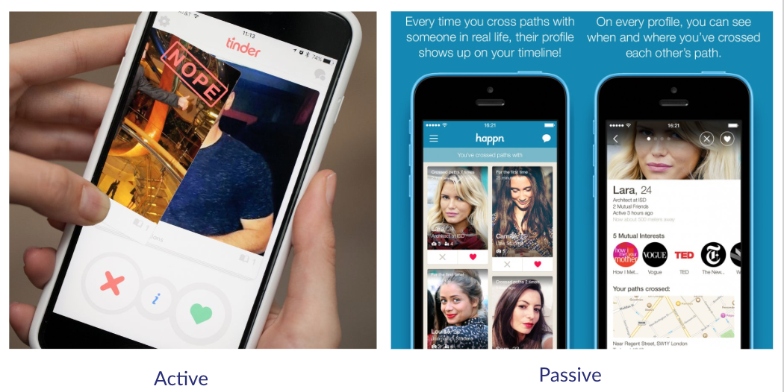
There’s more than one way..

Slide 18
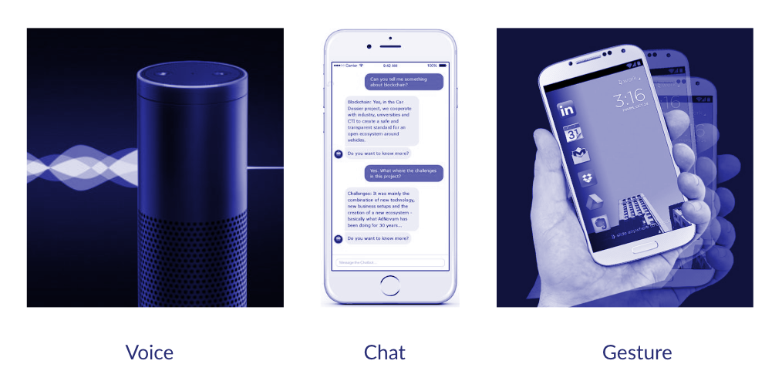

Slide 19
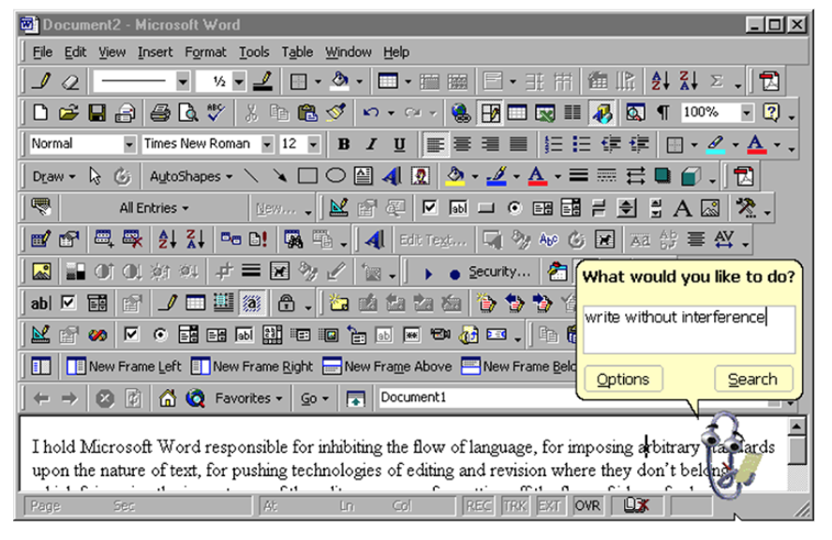
But keep it minimal!

Slide 20

UX Principles.

Slide 21

PRINCIPLE #1
Visibility of System Status

Slide 22
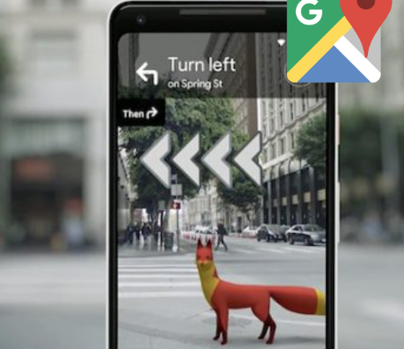
PRINCIPLE #2
Match between system and the real world

Slide 23
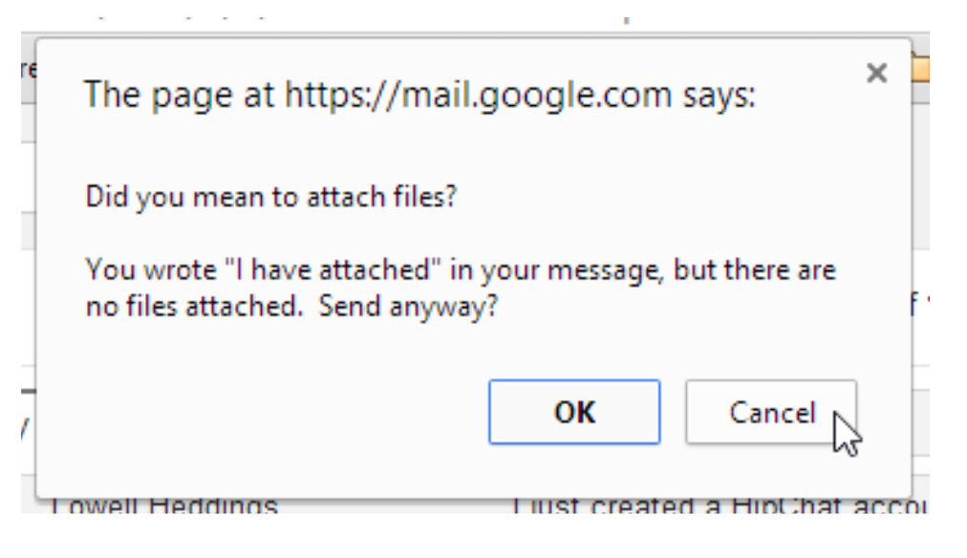
PRINCIPLE #3
Error Prevention

Slide 24
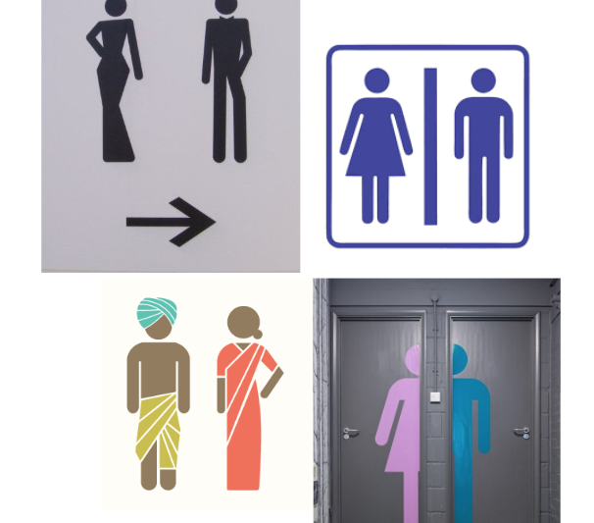
PRINCIPLE #4
Consistency and standards

Slide 25
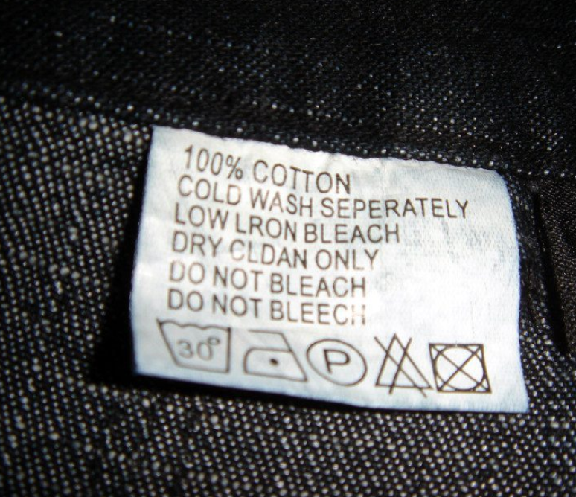
PRINCIPLE #5
Help and Documentation

Slide 26
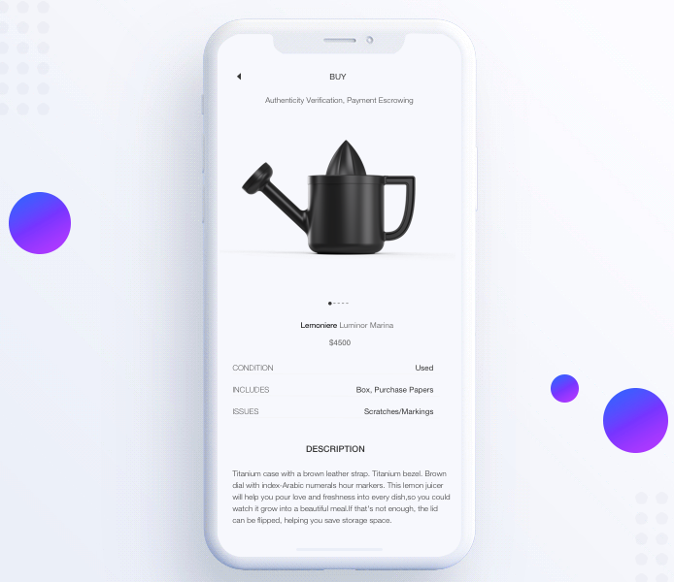
PRINCIPLE #6
Aesthetic and minimal UI

Slide 27
Step by Step
Understand the user Problems
Sharing
Prototype
As a group, list down some problems a first time job seeker faces.
Hear from everyone in the group about their ideas.
Quick and dirty concept prototypes to mockup your idea.
Step 01
Step 02
Step 03
Step 04
Step 05
Brainstorm Ideas
Selection
What different solutions can support our user meet his objectives?
Vote for 1 idea to prototype

Slide 28
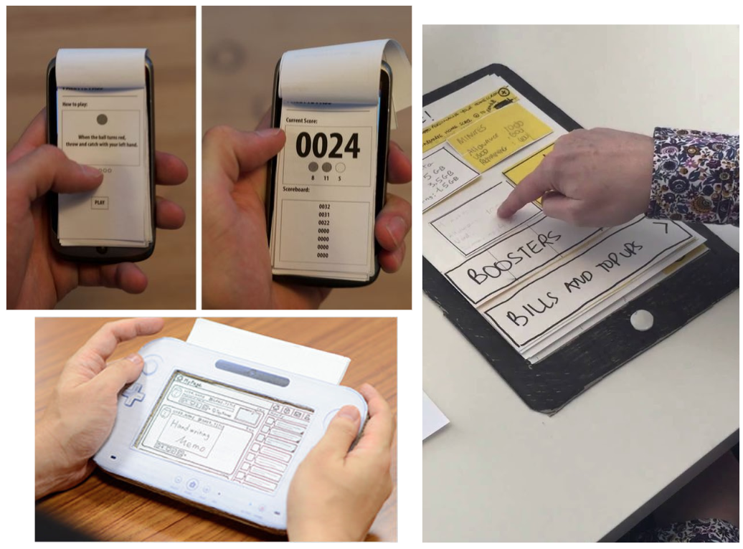

Slide 29
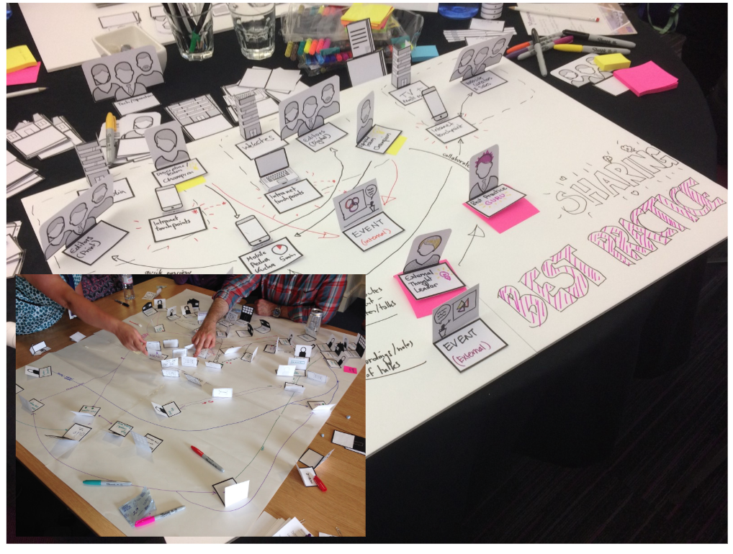

Slide 30
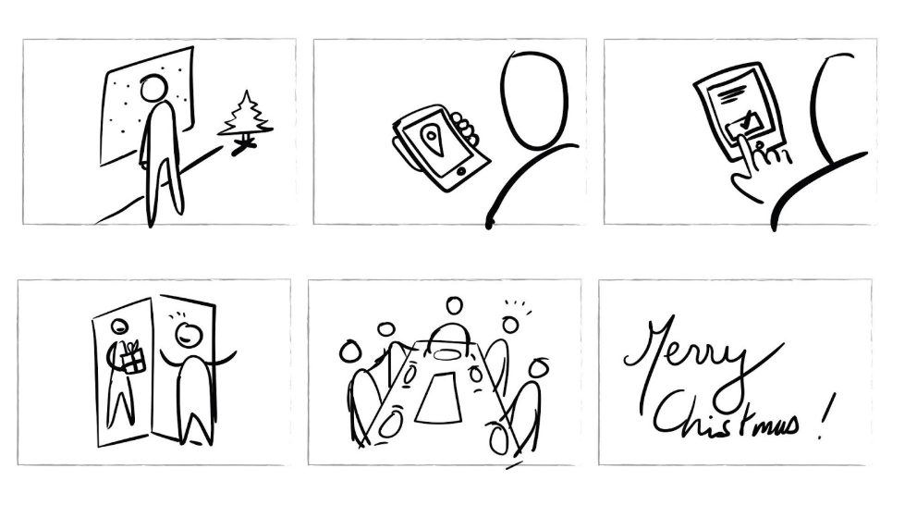

Slide 31
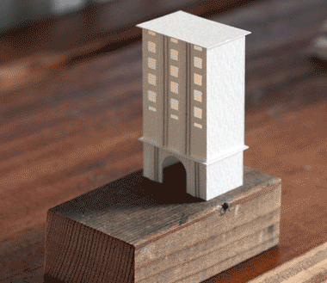
Let’s Prototype!

Slide 32
THANK YOU!
Nitya Kumar
nitya.k@numa.co

